Slide 1
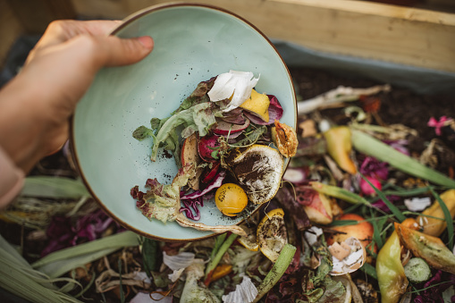
Food Shelter Don’t waste it, Donate it

Slide 2
68,760,163
Tonnes food waste per year

Slide 3
Leftover Food Listing
Type
Duration
Taker
Ensure that food is veg or non-veg
Gives the food duration after prepared
NGO
1
2
3
4
5
Quantity
Location
Check the quantity of food
State the pickup place

Slide 4
How NGO Distribute food
Baggers
Animals
Manure
According to the National Health Survey, 190 million people in India go to bed hungry every night.
6.2 Crore Dogs And 91 Lakh Cats Are Homeless In India
Composting these food creates a product that can be used to help improve soils, grow the next generation of crops, and improve water quality

Slide 5
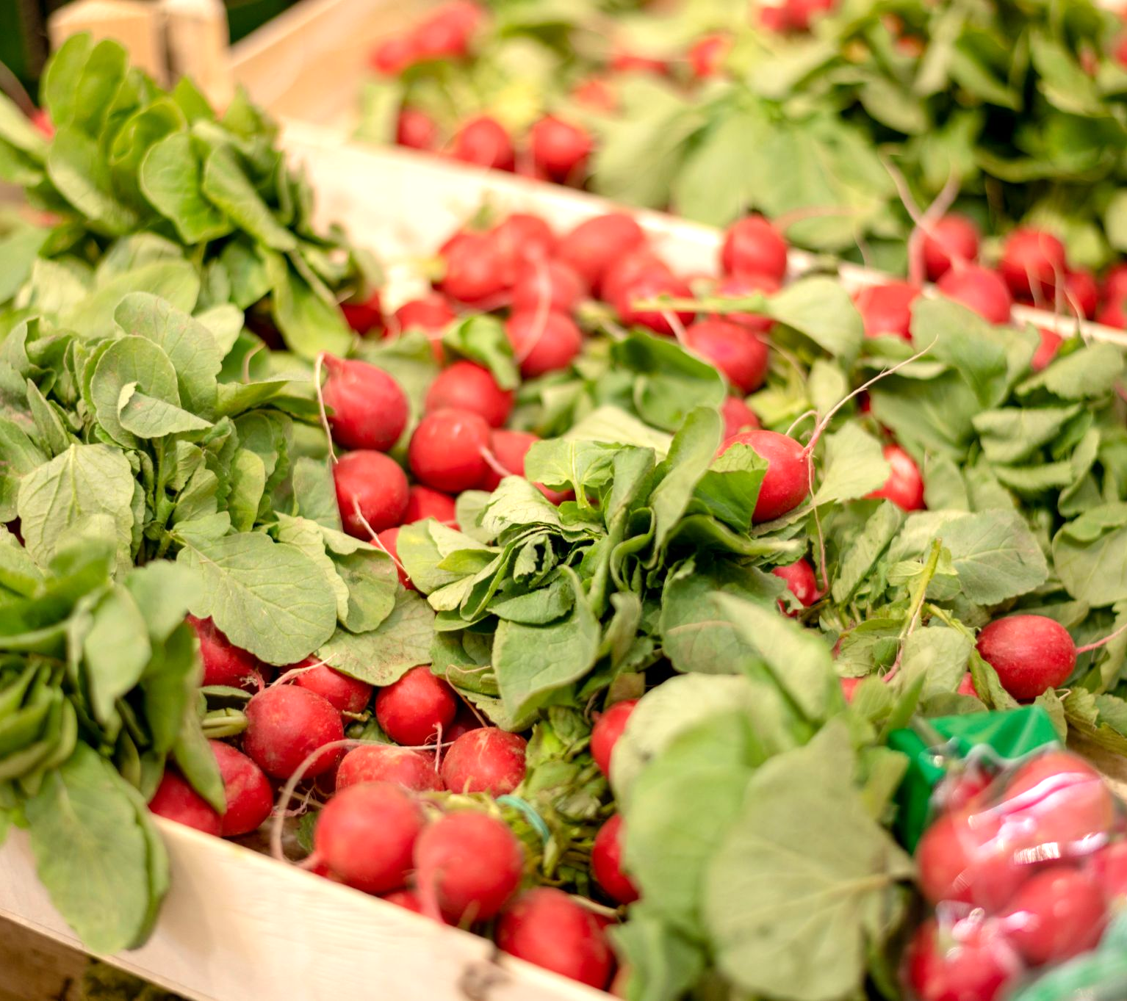
Leftovers aren’t trash ,They’re treasures-help us spread the wealth and feeld those in need.

Slide 6
Conclusion
“Our food shelter website has the potential to make a significant impact in reducing food waste and helping to provide for those in need.”

Slide 7

ABOUT US
We are undergraduates pursuing Bachelor of Technology from Indore institute of science and technology

Slide 8
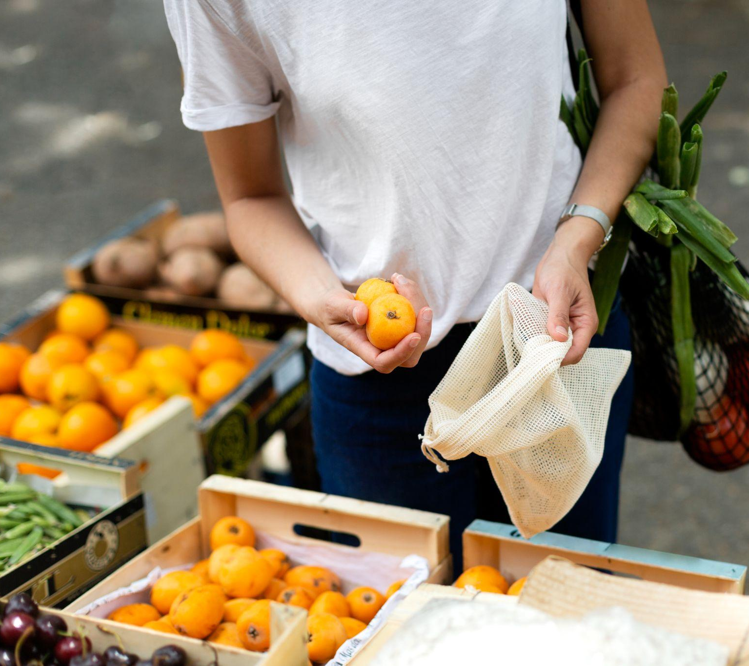
Thanks

